Slide 1
Building a millions of sensors driven IoT System
Massive scale ingestion, edge & near real-time processing
Shweta Gupta | @shwetastweets

Slide 2
Notes:
So let’s get down to business… this is what is IoT …everything we know.. And we will spend next one hour picking one of every component discussing stuff.
Pause…
Add protocol details,
Naa… I was just scaring you! Let’s start with this.. (change slide)

Slide 3
Notes:
Let’s take a step back, and draw our mind blank. We have so many things buzzing around us, that we some times go crazy. Where do we start. The next 50 minutes lets work together to build a system & and go through all aspects

Slide 4
Identifying a scenario
Notes:
This is absolutely critical. There is no one solution fits all problems. Each business problem needs to be looked at with magnifying glass. You can of course pick and choose tailored components ..
You know I am very regular at going to office and working. I like people around me … so I got to work daily. Unfortunately, I also have this collegue who feels the same. He comes in .. Lean and tall guy… salt and pepper look dressed in his business suits with tie.
He sits…lifts up his telephone and shouts at the admin “Kitna garam hai idhar” → which you all know means “How hot is it here, its crazy stifling .. Decrease the temperature right now”!
Now, I am a very tropical person.. Serious but tropical! So this is how I end up sitting….

Slide 5

Notes:
So this is how I end up sitting every day! You can even see the spare jackect in the background in case I forgot my red one… I used the purple one!
But I don’t blame him. Turns out that… his bay somehow the draft of the Air conditioning is not that intense…
Now obviously.. We could switch places! But I don’t want to do that!! I have a nice window view! And he has no view!

Slide 6
So our scenario…
Change the draft of the air automatically based on the temperature in cabins/squared areas.
Notes:
So we have

Slide 7
Let’s define our next steps
Step 1
Data sources
Step 2
Real-time action
Step 4
Step 5
Data processing
Take action
Step 3
Data ingestion

Slide 8
Step 1: Data sources

Slide 9
Aspects of data sources
Choosing the right hardware
Placement
Number of sensors
Costs
Power & voltage requirements
Data sources
Connectivity
Data format, structure
Security
Data capture
Device identification
Authentication
Authorization
Control
How will the sensors send data?
Wifi, Bluetooth, ethernet
Field gateway?
JSON/csv/text
Aggregation
Frequency
Compression
Notes:
https://www.edgefx.in/6-different-types-of-temperature-sensors-with-their-specifications/
First list down all the aspects
Then, speak a little bit about each aspect bullet points.
Get some guidance on choosing the right hardware

Slide 10
Data capture
Choosing the right hardware
Placement of the devices
Power, voltage & costs
Number of sensors
Notes:
http://www.yole.fr/iso_upload/Samples/Yole_IoT_June_2014_Sample.pdf
Thermisters, IR sensors, semiconductors, Thermometers, Resistors …
https://www.sensirion.com/products/humidity-sensors/humidity-temperature-sensor-sht2x-digital-i2c-accurate/
We generally have a home automation systems: Nextlabs, Honeywell …

Slide 11
Data capture
Choosing the right hardware
Placement of the devices
Power, voltage & costs
Number of sensors
Notes:
http://www.yole.fr/iso_upload/Samples/Yole_IoT_June_2014_Sample.pdf
Thermisters, IR sensors, semiconductors, Thermometers, Resistors …
Read and explain the appoints above.
https://www.sensirion.com/products/humidity-sensors/humidity-temperature-sensor-sht2x-digital-i2c-accurate/
We generally have a home automation systems: Nextlabs, Honeywell …

Slide 12
Our scenario
Average sensor range requires 1 in each bay area
Each floor has 10 such bays
Each building has 15 such floors
Each campus has 50 buildings
10 such campuses to manage
Sum: 2 x 10 x 15 x 50 x 50 = 750,000
Sum: 2 x 10 x 15 x 50 x 50 = 7500
Notes:
Let’s make some assumptions

Slide 13
Connectivity
Define the layout of devices
How will they send data? – wifi, Bluetooth, Ethernet
Where will the data be consolidated before sending it to the cloud
Will the sensors be directly connecting to the cloud?

Slide 14
Our scenario
Each floor has bays

Slide 15
Our scenario
One sensor per bay

Slide 16
Our scenario
One hub per floor that consolidates data for the floor

Slide 17
Our scenario
Gateway for each building
Notes:
It depends on how far apart our buildings our, we could have a gateway for a group of buildings, or for all buildings or for each building. Assuming they are disparately located, in our scenario we will go with one gateway for each building.

Slide 18
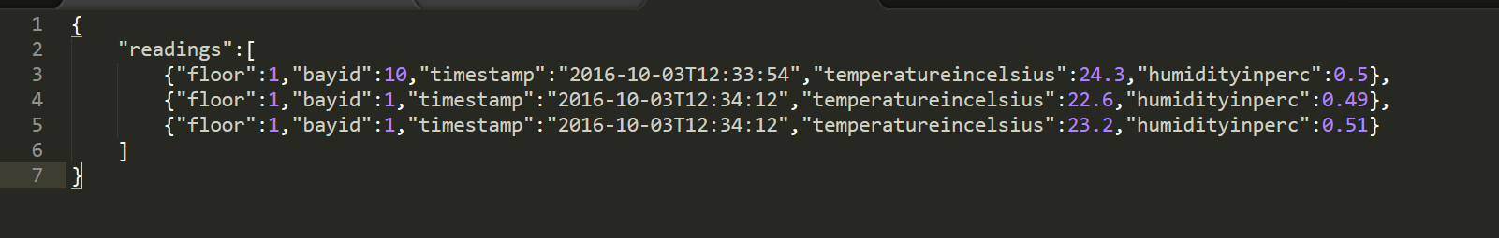
Data structure
JSON/CSV/Text
Collection or single messages?
Compressed
Our scenario (JSON collection)

Slide 19
Frequency
Factors to consider
Criticality
Timeliness
Connectivity
Costs
We will cover the costs in detail a little later down our journey…

Slide 20
Data ingestion

Slide 21
Factors to consider
Location
Throughput
Security
Authentication & Authorization
Encryption
Compression
Collection parsing

Slide 22
Our scenario
No. of sensors: 750,000
Throughput requirements:
Scenario | Frequency (in mins) | Message size (in bytes) | Throughput (Mb/day) | Iot HubCost per month (USD)
direct messages | 5 | 240 | 4943.85 | 2000
direct messages | 30 | 240 | 823.97 | 450
Aggregate messages | 5 | 34816 | 956.25 | 50
aggregate messages | 30 | 34816 | 159.83 | 50
compressed & aggregate messages | 5 | 5120 | 140.63 | 50
compressed & aggregate messages | 30 | 5120 | 23.44 | 50
Notes:
Fill this with a table that has the following calculations:
Columns: Scenario, Frequency, message size,Throughput bandwidth, No. of Iot Hub Units, HDInsight Spark (by bandwidth), VM costs, Costs,
Compare spark & Web Services option
In rows:
Scenario: direct messages, every 5 mins
direct messages, every 30 mins
aggregate messages, every 5 mins
aggregate messages, every 30 mins
compressed & aggregate messages, every 5 mins
compressed & aggregate messages, every 30 mins

Slide 23
Secured ingestion
Device registry
Security token
Authentication
Notes:
http://aka.ms/azureiotcost

Slide 24
Device registration
Register device with X.509 certificate
Azure IoT Hub
AWS Device Gateway
Return device
key details
Large scale ingestion

Slide 25
Secured ingestion

Slide 26
Secured ingestion
Notes:
This is replicated across all buildings.

Slide 27
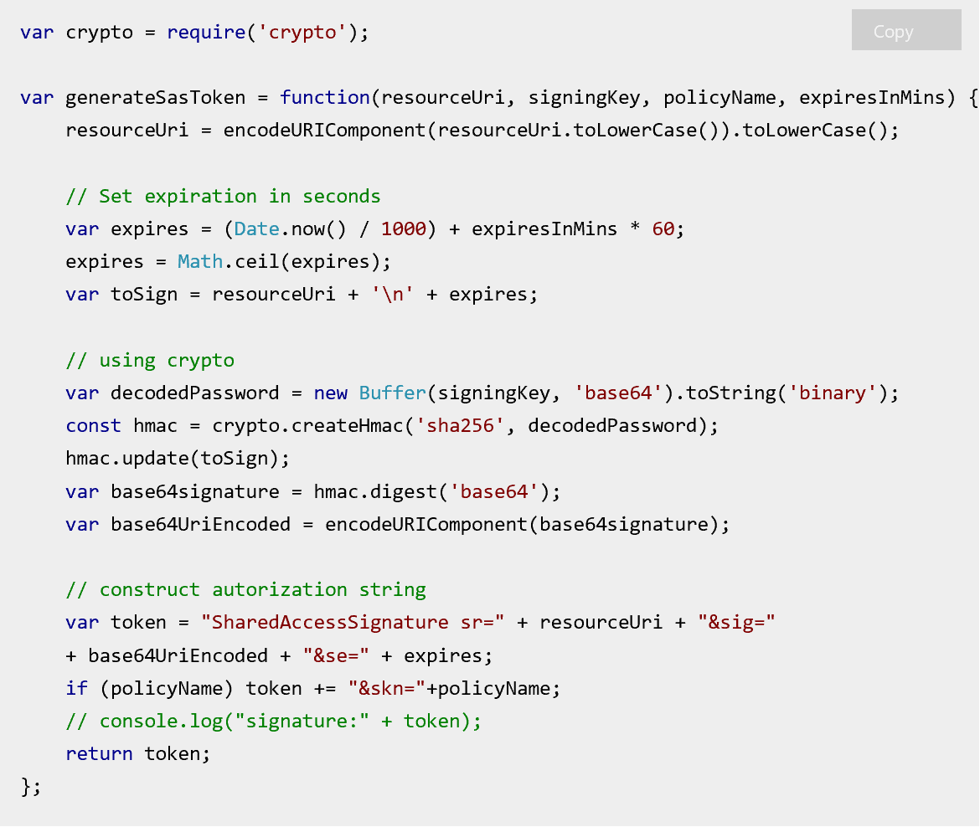
Generating SAS Token
Note: X.509 certificate does not include skn in the string

Slide 28
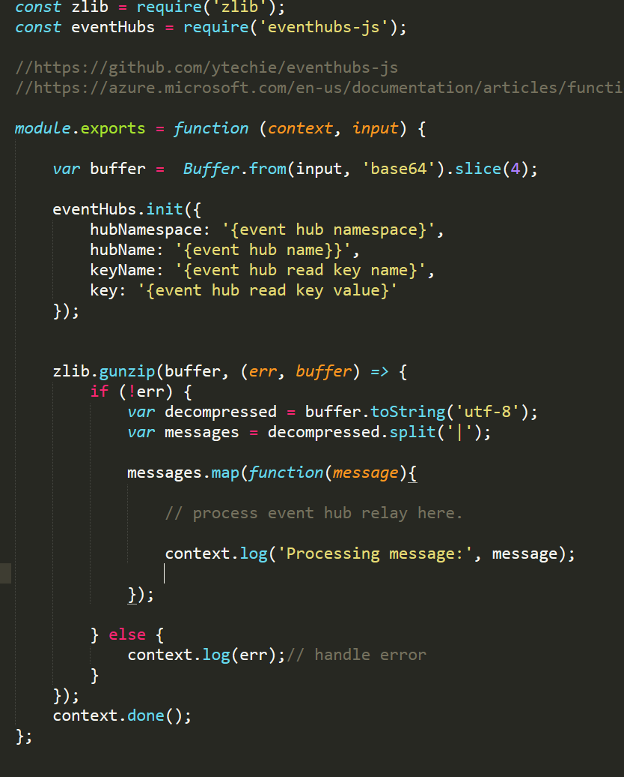
De-compression & De-aggregation
Generic compression & de-compression code which can be deployed (github)
https://github.com/Microsoft/iot-samples/blob/develop/AzureFunctionDecompShred/nodejs/azure-decompress.js
Notes:
Explain why we need it. As de-compression is not supported in IoT hub & in ASA.

Slide 29
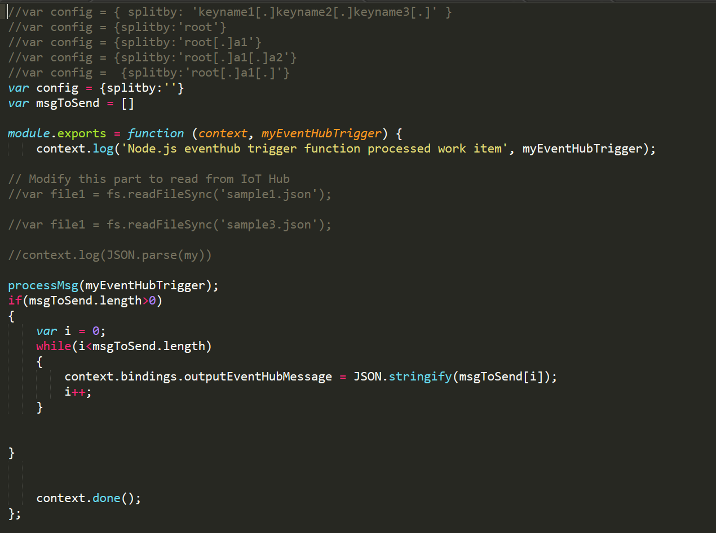
De-compression & De-aggregation
Generic de-aggregation code, based on configurable de-aggregation pattern
https://github.com/Microsoft/iot-samples/blob/develop/CollectionParsing/AzureFunctions/NodejsIotHubTrigger/index.js
Notes:
Explain why we need it. As de-compression is not supported in IoT hub & in ASA.

Slide 30
Data Ingestion – Our scenario
Building gateway consolidate & compress data
Gateway generate SaS token
Data is sent over to cloud Ingestion service over tls using the SaS tokens
IoT hub trigger function de-compresses & de-aggregates the data

Slide 31
Real-time analytics
Processing at the Edge
Lookout for a detailed session on Edge Analytics by Dharani & Aruna follow this one: Building the Internet of Everything – Intelligent Cloud, Intelligent Edge
Notes:
We have defined our data sources and data ingestion strategy, now there is always a latency.

Slide 32
Real-time Analytics
Immediate action/alerts
Aggregation (Averages, sum…)
Filters
Conversions
Notes:
What if we want to take an action immediately? Say if the temperature shoots up above 40/50 we want to raise an immediate alert

Slide 33
Our Scenario
Trigger a fire alarm if the temperature goes up
beyond a certain benchmark
Average of temperature & humidity every one minute
instead of every second
Notes:
What if we want to take an action immediately? Say if the temperature shoots up above 40/50 we want to raise an immediate alert

Slide 34
Edge Analytics
Process the data coming in from all sensors:
Average by every minute
Check if the value is greater than the benchmark – trigger the fire alarm

Slide 35
Step 3: Data processing

Slide 36
Decisions:
We need to check if any of the sensors is sending data that is above the benchmark temperature
Or below the benchmark temperature
Probably store the recorded temperature… observe user patterns
Alert if a sensor is not functioning or not sending data
Notes:
Now that we have the data coming into the IoT Hub, (it can retain data for 30 days) so we have time to think. ☺ …. :
Maybe it will be useful to check if someone has manually corrected the temperature. (maybe we can go back & modify it) --- check if you can modify the code on the fly to show how easy it should be.

Slide 37
So we have two paths:
Hot path
Near-real time
processing
Benchmark alerts
Inactive sensor alerts
Streaming data
Data storage
Store for future use
Cold path
Notes:
The typical hot and cold path.

Slide 38
Comparing various options
Option | Description | Best suited
Spark/HDInsight/ EMR | Spark running on custom Hadoop or HDInsight clusters that could process streaming data into both storages | Complex processing. For ex, running NLP algorithms on oncoming twitter feeds
Application on Virtual machines | Custom applications deployed on Virtual machines | Migration of legacy applications
App services | Custom code written, but managed by cloud. | Legacy code that could be deployed on PaaS
Functions / Lambda | Server less lightweight compute | Trigger based operations
Stream Analytics/ Kinesis Analytics | Queries in T-SQL that process streaming data in time windows | Conditional checking / processing in windows

Slide 39
Our scenario:

Slide 40
Our scenario:
Hot path
Cold path

Slide 41
Step 4: Take Action

Slide 42
Take action
What do we want to do if we a bay sensor records too hot or cold?
What do we want to do if a sensor is not sending data
What do we want to do with the sensor temperature that is being recorded
Notes:
We need to answer the following questions.

Slide 43
Take Action
What if a bay’s sensor records too hot or too cold?
Update live dashboard
Alert triggered
Send instructions to move the air draft

Slide 44
Take action

Slide 45
Take action

Slide 46
Step 5: Predict?
Notes:
I know I mentioned four steps, but since we have time let’s make use of the sensor data that is being recorded.

Slide 47
Going beyond reactive analytics
Temperature data
by bays, floor, building & campus
captured every half hour
manually triggered
external weather details
occupancy
build a temperature prediction model
Notes:
We have information on temperature for every corner of the campus, whether it was manually triggered?
What if
Manually triggered?
External weather details
Occupancy (based on HR attendance)
Build a Temperature prediction model

Slide 48
Going beyond reactive analytics
Weather forecasts
Outlook
calendar
Temperature prediction model
Set the
temperature
Attendance
(card swipe details)

Slide 49
Notes:
So let’s get down to business… this is what is IoT …everything we know.. And we will spend next one hour picking one of every component discussing stuff.
Pause…
Add protocol details,
Naa… I was just scaring you! Let’s start with this.. (change slide)

Slide 50
Seeing something in action
Notes:
Show the Power BI Dashboard

Slide 51
Demo Flow

Slide 52
Step 5: Getting Started
Notes:
I had built a prototype with help of some of my colleagues in office.
I couldn’t get it here, as I am on vacation in this beautiful place for next two weeks, either I could get this or my wardrobe, so the choice is obvious ☺ ….
I have recorded a video of this… let’s see it in action

Slide 53
Getting Started
Azure: https://channel9.msdn.com/Shows/themakershow/starterkits
https://docs.microsoft.com/en-us/azure/iot-hub/iot-hub-get-started
AWS: http://docs.aws.amazon.com/iot/latest/developerguide/iot-gs.html

